Slide 1

HR Data Analysis Project

Slide 2

Agenda
Executive Summary
Project Objectives
Data Cleaning & Modeling
The * schema
Dax code
Calculated Measure Table
SQL codes

Slide 3
Executive Summary
This HR Data Analysis Project aims to provide insights into workforce dynamics, employee qualifications, and organizational efficiency by leveraging data-driven decision-making.
The dataset encompasses personal employee details, business details, and employee feedback collected throughout their work periods.

Slide 4
By analyzing these data points, we seek tools for deep insights into the workforce to uncover trends, strengths, and areas for improvement across various aspects of the employee lifecycle.
Through comprehensive analysis, we will identify key drivers of employee engagement, performance, and retention, offering strategic recommendations to enhance HR policies, talent management, and overall business performance.
The findings from this study will support informed executive decision-making, ensuring alignment between workforce well-being and organizational objectives.

Slide 5
Project Objectives
1.Analyze Workforce Demographics & Distribution
Understand employee distribution across branches, roles, and qualifications.
Identify patterns in workforce diversity, tenure, and career progression.
2. Analyze Salary Pattern in the organization
3. Evaluate Employee Satisfaction & Work Experience
Assess employee perceptions of their jobs, work environment, relationships, and
the life/work balance.
Detect trends in employee engagement and dissatisfaction over time.

Slide 6
4. Measure Leadership & Managerial Effectiveness
Examine employees' ratings of managers and leadership impact.
Identify leadership strengths and areas requiring improvement.
5. Identify Factors Influencing Retention & Turnover
Analyze historical survey responses to determine predictors of employee attrition.
Provide data-driven recommendations for improving retention strategies.
6. Deliver actionable insights to optimize HR Strategies & Policies .

Slide 7
By addressing these objectives, this project will serve as a strategic tool for enhancing
employee engagement, improving managerial effectiveness, and fostering a productive and
satisfied workforce.

Slide 8

Data Cleaning & Modeling

Slide 9
Here are the detailed steps performed to the dataset to build up the desired analysis report.
Table | Actions
Performance Rating | 1- Rename columns. 2- Unpivot survey questions column. 3- Rename to (question) & (answer). 4- Separating the question in a new table by creating a new query for the (question) Column, rename the column, convert the query into a table, and rename it (Questions). 5- Add an index column to the new table and rename it (question ID). 6- Relate between the old and new tables by merging the tables to have the (question id) in the old one, then delete the column (question) in the old one. 7- Rename the old table (Survey).

Slide 10
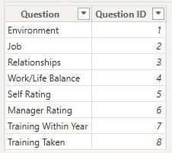
Here are the detailed steps performed to the dataset to build up the desired analysis report.
Table | Actions
Rating Level & Satisfied Level | 1- Classifying the answers of the questions as listed in these tables using Dax. And charts options. * 2- Delete both. 3- Notice that the Answers indexing set is as shown:

Slide 11
Here are the detailed steps performed to the dataset to build up the desired analysis report.
Table | Actions
Employee | 1- Making it tabular. 2- Arranging ascendingly by Employee ID (primary key). 3- Modifying column (Salary) type to currency. 4- Ensuring that years in most recent role <= years in company. 5- Column (Stock option level) contained values (0, 1, 2, 3) which is not aligned with rating system, modified to (1, 2, 3, 4), while taking care of beginning with the higher value to lower. 6- Correction of the cell value related to employee ID:(9758-DE2F), where the department was mistakenly assigned as (Technology), despite the employee's job role being (Sales Executive). The department updated to (Sales).** 7- Rename column (Education) to (EducationLevelID). 8- Add new conditional column (EducationLevel) using the attributes from table (EducationLevel). 9- Sort the column (EducationLevel) by the column (EducationLevelID) 10- Rename column (Attrition) to (Employment). 11- Replace values in column (Employment) as follows: Yes →Departed No →Active 12- Dividing the table into 2 tables: (Emp_Personal) which includes all personal details for each employee, and (Emp_Professional) which includes all work details for each one.

Slide 12
Here are the detailed steps performed to the dataset to build up the desired analysis report.
Table | Actions
Education Level | 1- Delete Table.

Slide 13
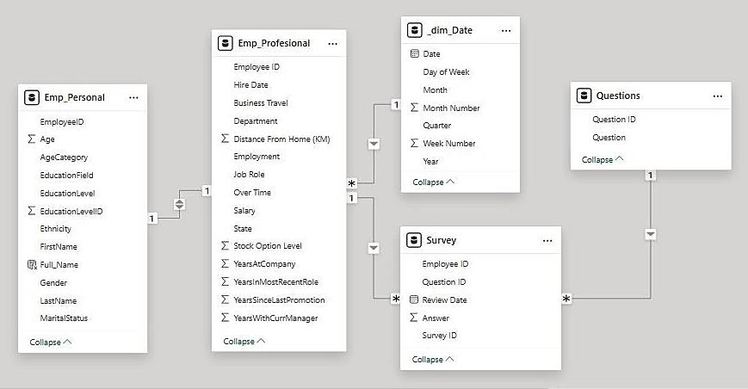
The * schema

Slide 14
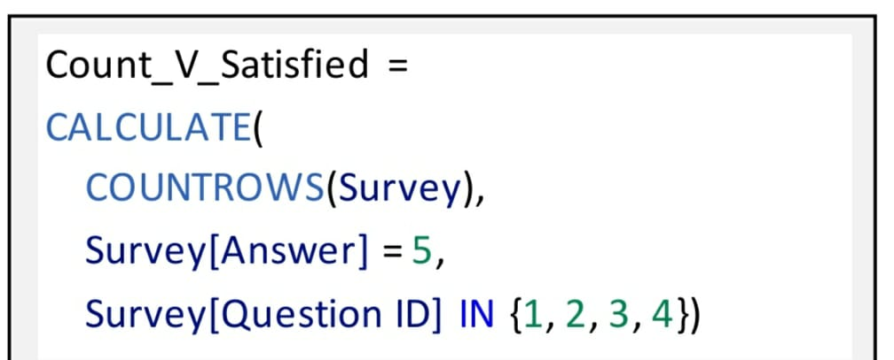
Dax Codes
* Example of Dax code to count the answers of 5 which means very satisfied in the satisfaction questions

Slide 15
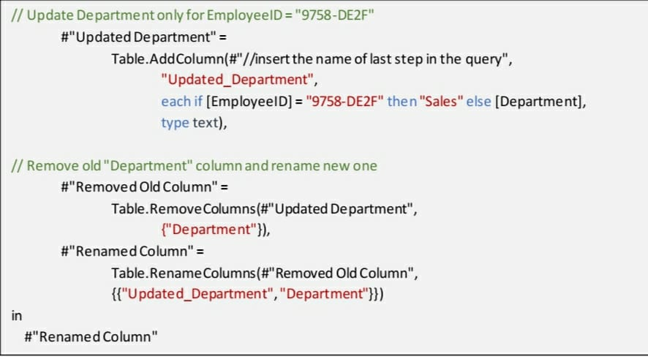
** The M language code for this modification in power query
Includes adding a new column with the value to be modified, then removing the original (department) column, and finally rename the new one, as below:

Slide 16
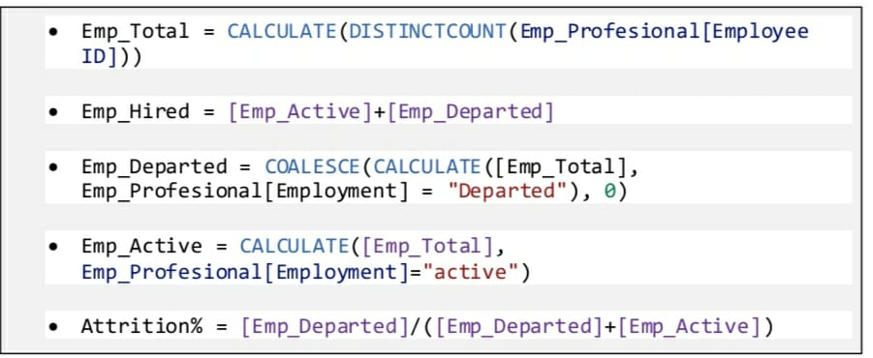
** Calculated Measure Table

Slide 17
SQL Codes
--Cleaning fact_Employee Table
--Remove duplicate employees
DELETE FROM fact_Employee
WHERE EmployeeID IN (
SELECT EmployeeID FROM fact_Employee
GROUP BY EmployeeID
HAVING COUNT(*) > 1);
--Remove employees with missing value in the main coulmns
DELETE FROM fact_Employee
WHERE EmployeeID IS NULL
OR FirstName IS NULL
OR LastName IS NULL
OR Gender IS NULL
OR Age IS NULL
OR Department IS NULL
OR Salary IS NULL;

Slide 18
--Remove invalid salary values
DELETE FROM fact_Employee
WHERE Salary <= 0;
--Remove employees with unrealistic ages
DELETE FROM fact_Employee
WHERE Age < 18 OR Age > 70;
--Change the department of employee id(9758-DE2F) from Technology into Sales
UPDATE fact_Employee
SET Department = 'Sales'
WHERE EmployeeID = '9758-DE2F';

Slide 19
--Cleaning Dim_SatisfiedLevel Table
DELETE FROM Dim_SatisfiedLevel
WHERE SatisfactionLevel IS NULL
OR SatisfactionID NOT IN (1, 2, 3, 4, 5);
--Ensuring Referential Integrity
--Remove employees with invalid education levels
DELETE FROM fact_Employee
WHERE EducationLevelID NOT IN (SELECT EducationLevelID FROM Dim_EducationLevel);

Slide 20
--Remove performance ratings for non-existent employees
DELETE FROM fact_PerformanceRating
WHERE EmployeeID NOT IN (SELECT EmployeeID FROM fact_Employee);
--Normalize OverTime Values
UPDATE fact_Employee
SET OverTime = 'Yes'
WHERE OverTime ILIKE 'yes' OR OverTime ILIKE 'y' OR OverTime ILIKE 'true' OR OverTime =
'1';
UPDATE fact_Employee
SET OverTime = 'No'
WHERE OverTime ILIKE 'no' OR OverTime ILIKE 'n' OR OverTime ILIKE 'false' OR OverTime =
'0';

Slide 21
--Normalize Gender Values
UPDATE fact_Employee
SET Gender = 'Male'
WHERE Gender ILIKE 'm' OR Gender ILIKE 'male';
UPDATE fact_Employee
SET Gender = 'Female'
WHERE Gender ILIKE 'f' OR Gender ILIKE 'female';
--Normalize MaritalStatus Values
UPDATE fact_Employee
SET MaritalStatus = 'Single'
WHERE MaritalStatus ILIKE 'single';
UPDATE fact_Employee
SET MaritalStatus = 'Married'
WHERE MaritalStatus ILIKE 'married';
UPDATE fact_Employee
SET MaritalStatus = 'Divorced'
WHERE MaritalStatus ILIKE 'divorced';

Slide 22
--Validating Numeric Ranges
--Validate Salary Range
DELETE FROM fact_Employee
WHERE Salary < 10000 OR Salary > 600000;
--Validate YearsAtCompany
DELETE FROM fact_Employee
WHERE YearsAtCompany < 0 OR YearsAtCompany > 50;
--Validate YearsInMostRecentRole (not exceed YearsAtCompany)
DELETE FROM fact_Employee
WHERE YearsInMostRecentRole > YearsAtCompany;
--Validate YearsSinceLastPromotion (not exceed YearsAtCompany)
DELETE FROM fact_Employee
WHERE YearsSinceLastPromotion > YearsAtCompany;
--Validate YearsWithCurrManager (not exceed YearsAtCompany)
DELETE FROM fact_Employee
WHERE YearsWithCurrManager > YearsAtCompany;

Slide 23

Thank you

